Slide 1
How to Submit Your Results: Maize & Cocoa Challenges
By Simon Allan Achuka

Slide 2
Submission Format
All submissions will be in CSV (Comma-Separated Values) format.

Slide 3
Maize Classification
Evaluation Metrics:
Log Loss
F1 Score
Submission File:
Header: filename, MLB, MLN, MSV, FAW, Healthy
Content: Each row represents probabilities for each disease category for a specific image filename. Values should be between 0 and 1.

Slide 4
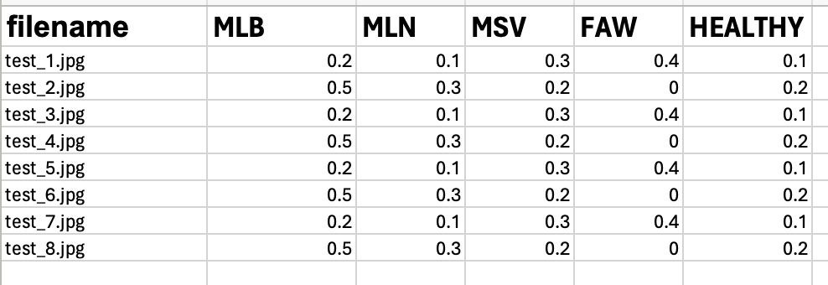
Example Submission File:

Slide 5
Maize Disease Detection (This is an optional Task and will not be graded
Evaluation Metrics
Mean Average Precision @ Intersection over Union (IoU) threshold 0.5 (mAP50)
Mean Average Precision from 0.5 to 0.95 IoU (mAP50-95)

Slide 6
Maize Detection Submission file
Header: filename, Class, Confidence, ymin, xmin, ymax, xmax
Content: Each row represents a detected bounding box in an image.
Class: The disease class (e.g., MLB, MSV, MLN)
Confidence: Confidence score of the detection (between 0 and 1)
ymin, xmin, ymax, xmax: Normalized bounding box coordinates (between 0 and 1)
ymin: Top-left y-coordinate (0 at the top of the image)
xmin: Top-left x-coordinate (0 at the left of the image)
ymax: Bottom-right y-coordinate (1 at the bottom of the image)
xmax: Bottom-right x-coordinate (1 at the right of the image)

Slide 7
Example
filename,Class,Confidence,ymin,xmin,ymax,xmax
test_1.jpg,MSV,0.73,0.008,0.26,0.96,0.99
test_2.jpg,MLN,0.85,0.1,0.3,0.7,0.9

Slide 8
Cocoa Stage detection
Evaluation Metrics
Mean Average Precision @ Intersection over Union (IoU) threshold 0.5 (mAP50)
Mean Average Precision from 0.5 to 0.95 IoU (mAP50-95)

Slide 9
Cocoa Stage Detection Submission file
Header: filename, Class, Confidence, ymin, xmin, ymax, xmax
Content: Each row represents a detected bounding box in an image.
Class: The cocoa class (e.g. cocoa mature unripe, cocoa immature, cocoa ripped or cocoa spoilt.)
Confidence: Confidence score of the detection (between 0 and 1)
ymin, xmin, ymax, xmax: Normalized bounding box coordinates (between 0 and 1)
ymin: Top-left y-coordinate (0 at the top of the image)
xmin: Top-left x-coordinate (0 at the left of the image)
ymax: Bottom-right y-coordinate (1 at the bottom of the image)
xmax: Bottom-right x-coordinate (1 at the right of the image)

Slide 10
Example Submission file

